Slide 1



奇妙嬰兒天然系列

Slide 2



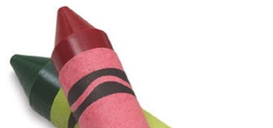
燦爛開心的將來全賴健康的開始。
- DNA奇妙嬰兒系列
“Brighter days and better tomorrows only exist through healthy beginnings.”
-This is the DNA Way

Slide 3

按每千名
人口計算
per 1000 population
http://www.statistics.gov.hk/pub/B71312FA2013XXXXB0100.pdf

Slide 4
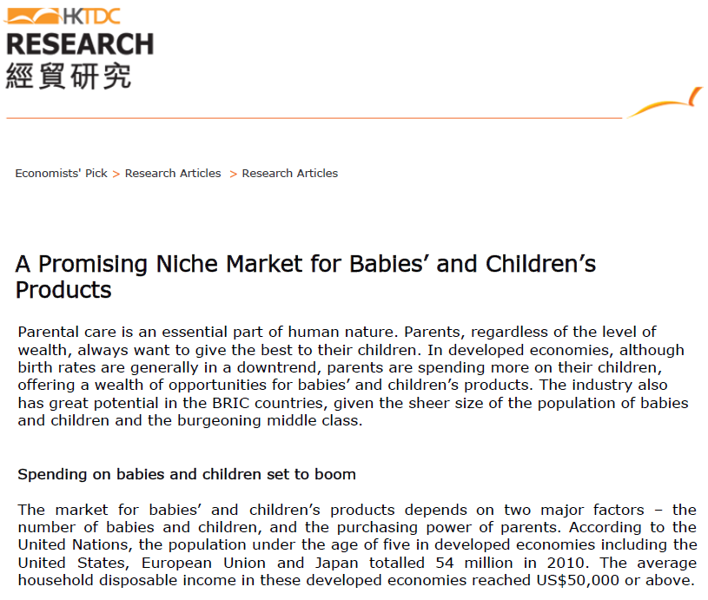
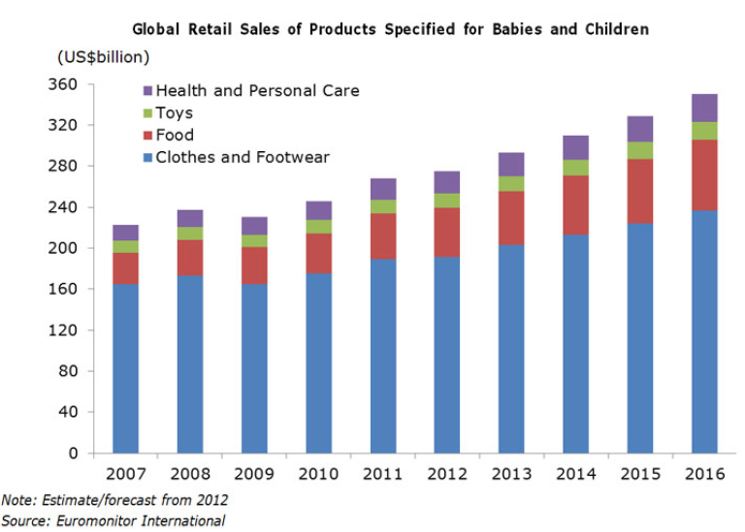
嬰兒及兒童產品的全球零售數字
保健及護理產品
玩具
嬰兒食品
服裝類別
嬰童產品市場前景明朗
嬰童產品開支勢必增加
嬰兒及兒童產品市場的發展視乎兩大要素，分別是嬰兒和兒童數目以及父母的購買力。
Notes:
http://www.hktdc.com/mis/ahktdc/tc/s/abt-hktdc-about.html?

Slide 5

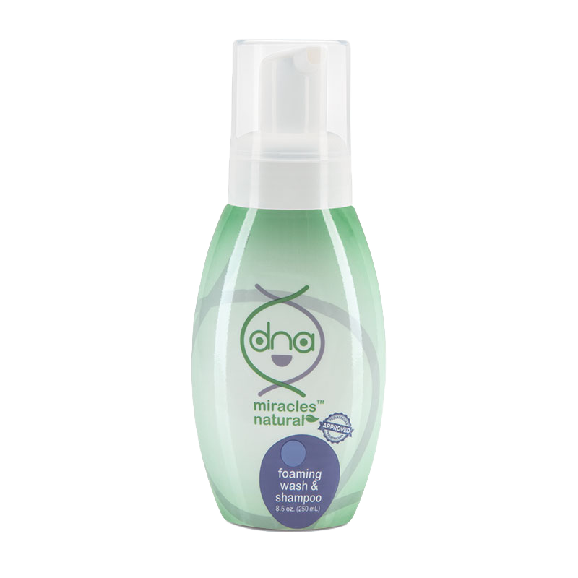
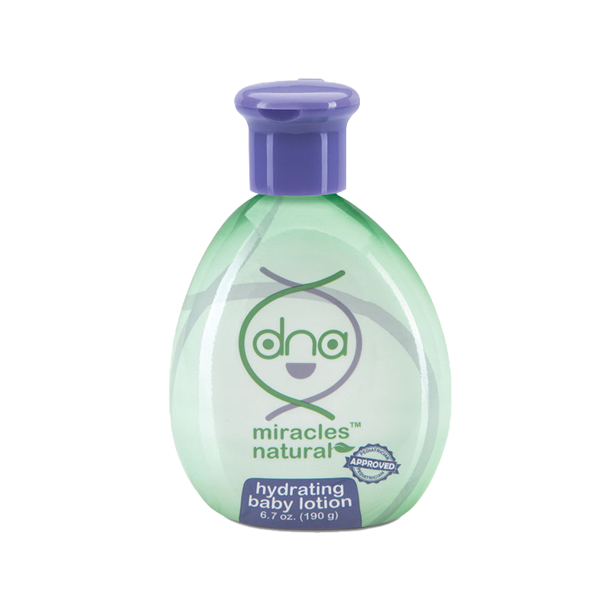
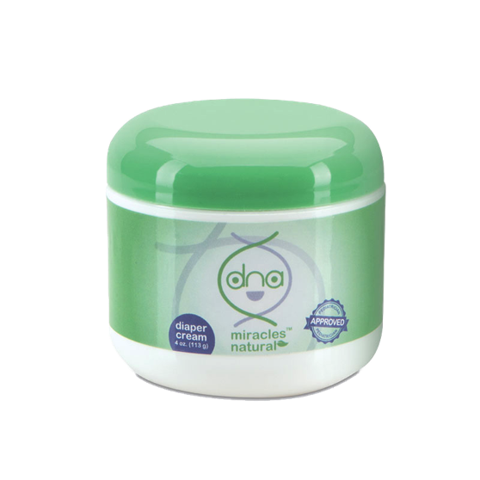
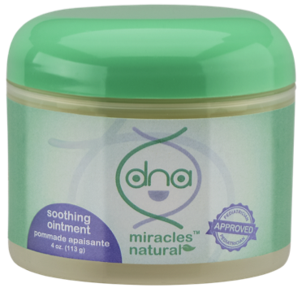


Slide 6
奇妙嬰兒天然洗髮沐浴泡泡
DNA Miracles Natural Foaming Wash & Shampoo
天然、溫和、無毒性的沐浴露，專為嬰兒細緻的皮膚和頭髮而設，適合初生嬰兒使用。
含有以椰子油製造的界面活性劑，能溫和潔淨皮膚與頭髮
滋潤並調理寶寶的頭髮
A natural, gentle, non-toxic body cleanser specially formulated for your baby's delicate skin and hair. Suitable for newborn use.
Gently cleanses the skin and hair with surfactants derived from coconut oil
Moisturize and conditions your baby’s hair
HK6932 | DC $81.00 | SR $113.00 | BV 6

Slide 7
奇妙嬰兒天然洗髮沐浴泡泡
DNA Miracles Natural Foaming Wash & Shampoo
主要成份：
水
溫和界面活性劑
椰油脂酸甘油酯類
泛醇
柳草花／葉／莖萃取物
Key Ingredients:
Water
Gentle Surfactants
Cocoglycerides
Panthenol
Epilobium angustifolium (Willowherb) Flower / Leaf / Stem Extract
HK6932 | DC $81.00 | SR $113.00 | BV 6

Slide 8
奇妙嬰兒天然潤膚乳液
DNA Miracles Natural Hydrating Baby Lotion
天然、無毒性的潤膚乳液，專為嬰兒敏感的面部與身體肌膚而設；性質溫和，適合初生嬰兒使用。
內含多種潤膚成份與草本植物萃取物，能為肌膚保濕，讓肌膚外表與觸感更細滑柔嫩
支援肌膚的正常防護功能，幫助肌膚保濕
有助紓緩肌膚輕微刺激
A natural, non-toxic body lotion specially formulated for your baby's face and body. Gentle on baby's sensitive skin and suitable for newborn use.
Moisturizes with a combination of emollients and herbal extracts for skin that looks and feels smoother and softer
Supports normal skin barrier functions to help keep the skin hydrated
Helps soothe minor skin irritations
HK6930 | DC $81.00 | SR $113.00 | BV 5.5

Slide 9
奇妙嬰兒天然潤膚乳液
DNA Miracles Natural Hydrating Baby Lotion
主要成份：
水
甘油
蘆薈葉汁
乳木果油
玻尿酸鈉
柳草花／葉／莖萃取物
Key Ingredients:
Water
Glycerin
Aloe barbadensis (Aloe Vera) Leaf Juice
Shea Butter
Sodium Hyaluronate
Epilobium angustifolium (Willowherb) Flower / Leaf / Stem Extract
HK6930 | DC $81.00 | SR $113.00 | BV 5.5

Slide 10
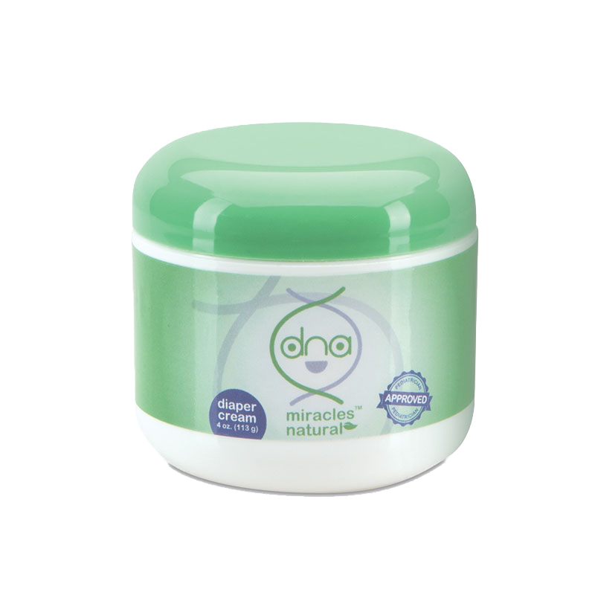
奇妙嬰兒天然抗敏護膚膏
DNA Miracles Natural Diaper Cream
天然、無毒性的護膚膏，專為滋潤、紓緩和保護寶寶較敏感部位的肌膚而設。
有助防止輕微的皮膚刺激，令寶寶的皮膚柔嫩細滑
有助保濕、紓緩和保護寶寶的敏感肌膚
支援肌膚的正常防護功能，幫助肌膚保濕
A natural, non-toxic cream specially formulated to moisturize, soothe and protect your baby’s sensitive areas.
Helps insulate against minor skin irritation to keep your baby’s skin soft and smooth
Helps moisturize, soothe and protect your baby’s sensitive areas.
Supports normal skin barrier functions to help keep the skin hydrated.
HK6931 | DC $89.00 | SR $125.00 | BV 7.5

Slide 11
奇妙嬰兒天然抗敏護膚膏
DNA Miracles Natural Diaper Cream
主要成份：
水
甘油
椰子油
蘆薈葉汁
柳草花／葉／莖萃取物
氧化鋅
Key Ingredients:
Water
Glycerin
Coconut Oil
Aloe barbadensis Leaf Juice
Epilobium angustifolium (Willowherb) Flower / Leaf / Stem Extract
Zinc Oxide
HK6931 | DC $89.00 | SR $125.00 | BV 7.5

Slide 12

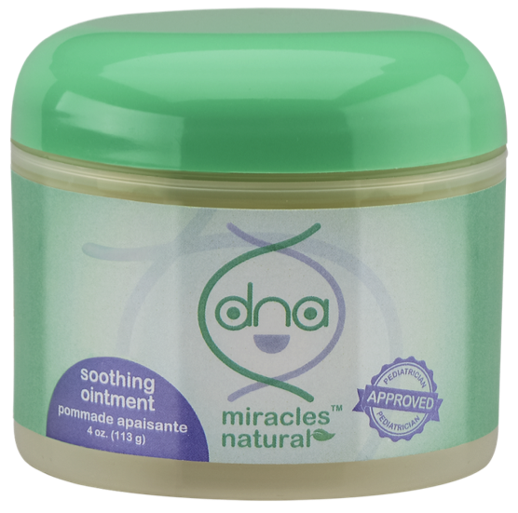



Slide 13


奇妙嬰兒天然舒緩膏
DNA Miracles Natural Soothing Ointment
配方絕無毒性，能有效紓緩肌膚，同時性質溫和，呵護最細緻柔嫩的肌膚。
有助紓緩肌膚
滋潤乾燥肌膚
鎖緊肌膚水分
含有天然成份，保護敏感肌膚
Nontoxic formula strong enough to soothe and yet gentle enough for the softest skin.
Helps soothe skin
Moisturizes dry skin areas
Locks in moisture
Uses natural ingredients to protect sensitive skin

Slide 14
奇妙嬰兒天然舒緩膏
DNA Miracles Natural Soothing Ointment
主要成份：
椰子油
神經醯胺3
柳草花／葉／莖萃取物
異山梨醇二辛酸酯
Key Ingredients:
Coconut Oil
Ceramide 3
Epilobium angustifolium (Willowherb) Flower / Leaf / Stem Extract
Isosorbide Dicaprylate

Slide 15

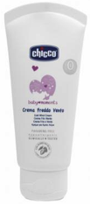
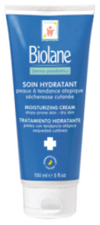


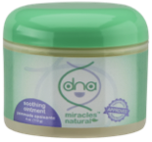

DNA奇妙嬰兒天然舒緩膏的比較
Soothing Ointment VS. Competitors
 | DNA Soothing Ointment | Seba Baby Cream | Chicco Cold Wind Cream | Biolane Moisturizing Cream | Cherub Rubs Organic Skin Balm
兒科醫生認可Pediatrician Approved |  | √ | × | √ | ×
95%天然成份 95% Natural Ingredients |  | × | × | × | √
不含苯甲酸酯Free of Parabens |  | √ | √ | √ | √
每毫升價格Price Per mL |  | $0.98 | $2.76 | $0.90 | $2.47
 | DNA Soothing Ointment
兒科醫生認可Pediatrician Approved | √
95%天然成份 95% Natural Ingredients | √
不含苯甲酸酯Free of Parabens | √
每毫升價格Price Per mL | $1.50
Notes:
Cherub Rubs - http://www.cherubrubs.com.sg/skin.html
Mustela Moisturizing Cream - http://www.mustela.hk/content/Body-milk
Chicco Cold Wind Cream - http://www.chicco.com.hk/product_detail.php?cat=47&sub=66&id=316
Seba Baby Cream - http://www.sebamed.com/products/product.html?tx_nsproductdatabase_pi1[showUid]=160&lastpid=1377&cHash=402c74802b082a57a3f77d34a06b0909

Slide 16
奇妙嬰兒天然舒緩膏
DNA Miracles Natural Soothing Ointment
HK6930
DC $122.00
SR $170.00
BV 10

Slide 17

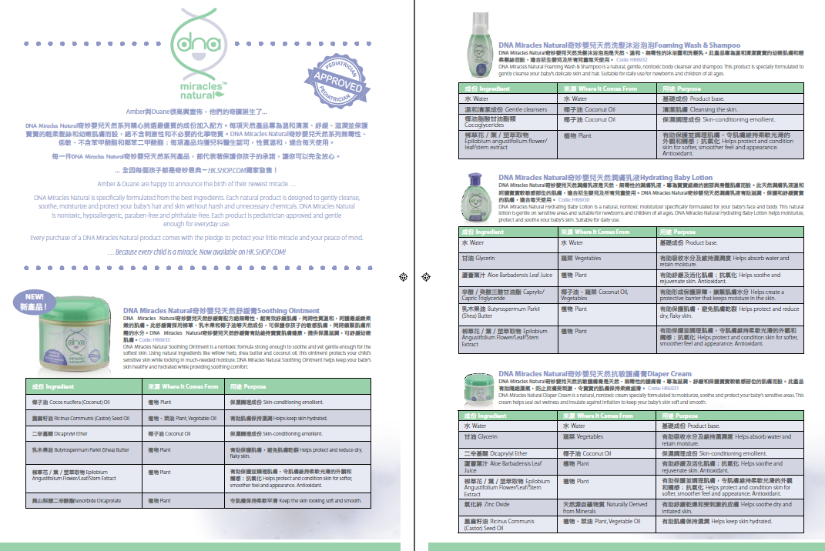
下載產品單張
Downloadable Leaflet

Slide 18

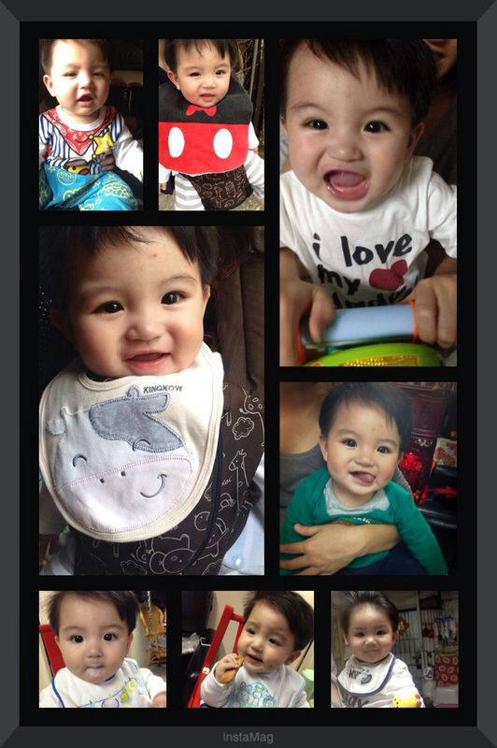
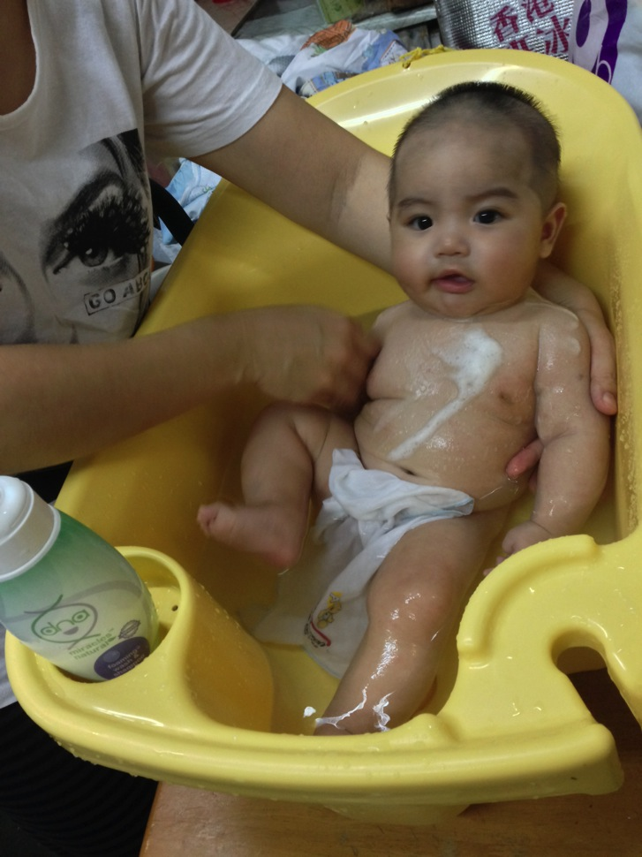

Slide 19
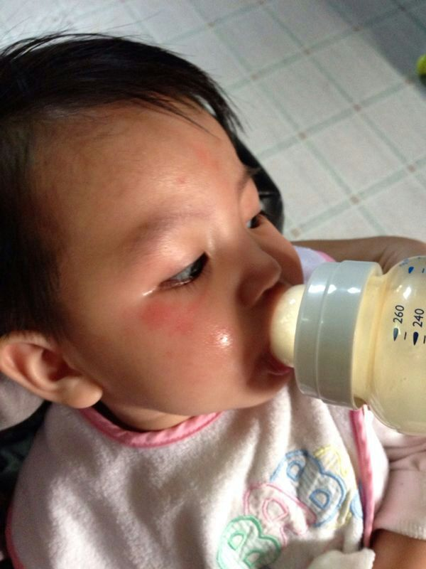
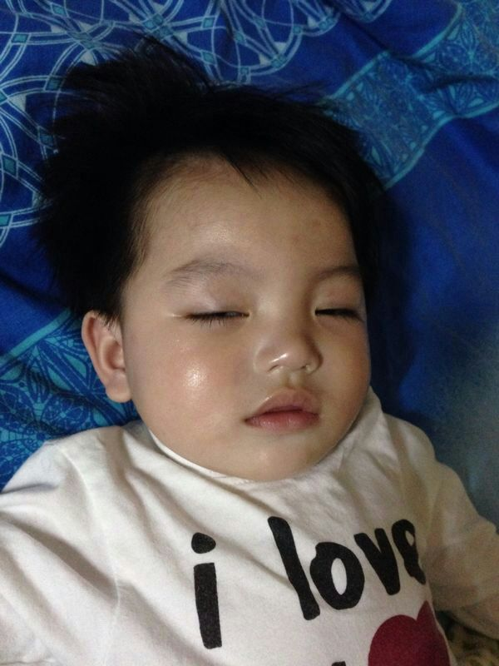

Slide 20




產品專題會暨健康講座
Product Symposium and Health Seminar
日期：2014年7月13至14日（星期日及一）
地點：灣仔會議展覽中心及美安生活廊
門票：HK$1,190
優先特惠門票：HK$990（須於2014年4月4日至5月4日期間，購買三張2014領袖訓練會議門票方可享此優惠)
Date: July 13 – July 14, 2014 (Sunday and Monday)
Venue: HKCEC and mhk Showcase
Ticket Price: HK$1,190
Early Bird Ticket Price: HK$990 (Enjoy early bird ticket price with the purchase of three 2014 Leadership School tickets during 4 April to 4 May as prerequisite)

Slide 21
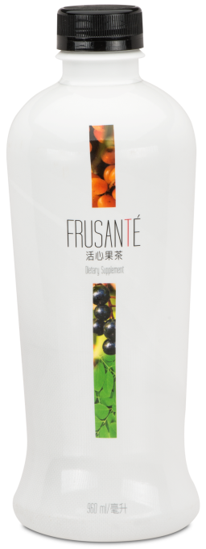


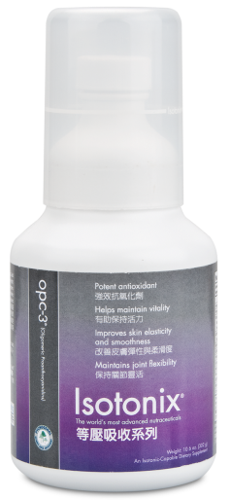

All
總值
HK$3,655
VALUE
你一定要有的3張門票！
it
takes
3
is
“I Got My 3”禮品：
Isotonix® OPC-3®
Frusanté®活心果茶一瓶
美安香港網路中心 mhk WebCenters™

Slide 22

嶄新的公司，嶄新的機會，嶄新的你
2014美安香港年會
mhk Annual Convention
#MHKAC2014

